Slide 1

Minimum Spanning Tree Algorithm
Submitted by:
Amrit Raj
181210008
CSE 2nd Year
Submitted to:
Chandresh Kumar Maurya

Slide 2
Contents
Minimum Spanning Tree
Krushkal’s Algorithm
Prim’s Algorithm

Slide 3
Minimum Spanning Tree
What is minimum spanning tree?
A tree that covers (spans) all the vertices of a connected graph which has the minimum total cost of edges in the tree.
An MST exists for a graph iff the graph is connected.
The same problem makes sense for directed graphs too, but the solution is more difficult.
Our problem is finding a minimum spanning tree in directed and undirected graph.

Slide 4
Minimum Spanning Tree
Properties:
If the number of vertices of a connected undirected graph is |V|, then its minimum spanning tree will have
|V| vertices
|V| - 1 edges.
A MST does not contain any cycle, since it is a tree.
If we add an extra edge to a MST, then it will have a cycle.
Two main algorithms for computing MSTs
Krushkal’s Algorithm
Prim’s Algorithm

Slide 5
Generic MST Algorithms
Maintain a set of edges : A
Loop invariant: A is a subset of some MST
Safe edge (u,v): A U {(u,v)} is also a subset of an MST
Generic-MST(G, w)
A = empty set
while A does not form a spanning tree do
find an edge (u,v) that is safe for A
A = A U {(u,v)}
return A

Slide 6
Krushkal’s Algorithm
Add edges to A in increasing order of weights.
If the edge being considered introduces a cycle, skip it.
Otherwise add to A.
Notice that the edges in A make a forest, and they keep getting merged together.

Slide 7
Krushkal’s Algorithm
Kruskal(G=(V,E), w) {
A = empty set
for each (u in V)
CreateSet(u)
Sort E in increasing order by weight
for each ((u,v) from the sorted list E)
{
if (FindSet(u) != FindSet(v))
{
Add(u,v) to A
Union(u,v)
}
}
return A
}
Time Complexity
Θ(E log E) for sorting the edges
O(V log V + E) for a sequence of E union find operations
Total : O(E log E) since (E >= V-1)

Slide 8
Prim’s Algorithm
Edges in A always form a tree (partial MST)
Start from a vertex r and grow until the tree spans all vertices
Let S denote the set of vertices which are on this partial MST
A is the set of edges connecting the vertices in S
At each stage the light edge crossing (S, V-S) is added to A

Slide 9
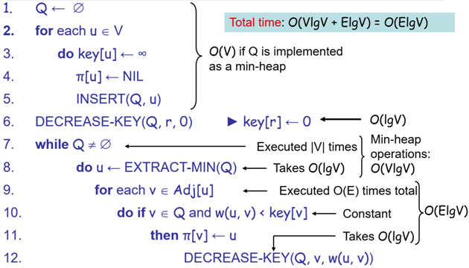
Prim’s Algorithm

Slide 10
END OF SLIDES
THANK YOU

